Slide 1







Robust M-Estimation Based SVM
for Improving Binary Classification
이중 분류 성능 향상을 위한 강건한 M-추정 기반 SVM
김민경, 유지아, 윤진희
Min Kyung Kim, Jia You, Jin Hee Yoon
Sejong Univ., South Korea

Slide 2
Introduction
L1-SVMs and L2-SVMs
Limitations of L1-SVMs and L2-SVMs
M-estimator-based SVM
Data Analysis
Conclusion

Slide 3

1. Introduction
• Support Vector machines are widely used for binary classification problems.
• The advantages of SVMs over conventional methods are high generalization ability
especially when the number of training data is small, adaptability to various classification
problems by changing kernel functions, and global optimal solution obtained by quadratic
programming.
• Support vector machines with linear sum of slack variables, which are commonly used,
are called L1-SVMs, and SVMs with the square sum of slack variables are called L2-SVMs.
L2-SVMs is unstable if there are outliers present in data.
03

Slide 4
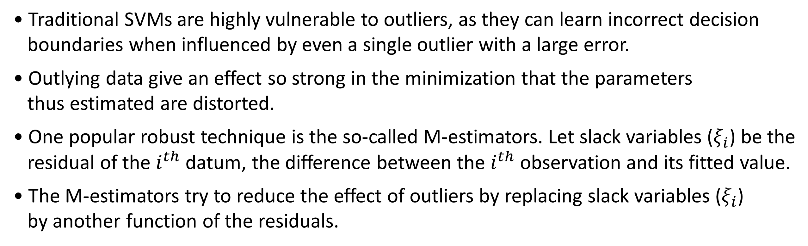
1. Introduction
• Traditional SVMs are highly vulnerable to outliers, as they can learn incorrect decision
boundaries when influenced by even a single outlier with a large error.
• Outlying data give an effect so strong in the minimization that the parameters
thus estimated are distorted.
• One popular robust technique is the so-called M-estimators. Let slack variables ($ξ_{i}$) be the
residual of the $i^{th}$ datum, the difference between the $i^{th}$ observation and its fitted value.
• The M-estimators try to reduce the effect of outliers by replacing slack variables ($ξ_{i}$)
by another function of the residuals.
04

Slide 5
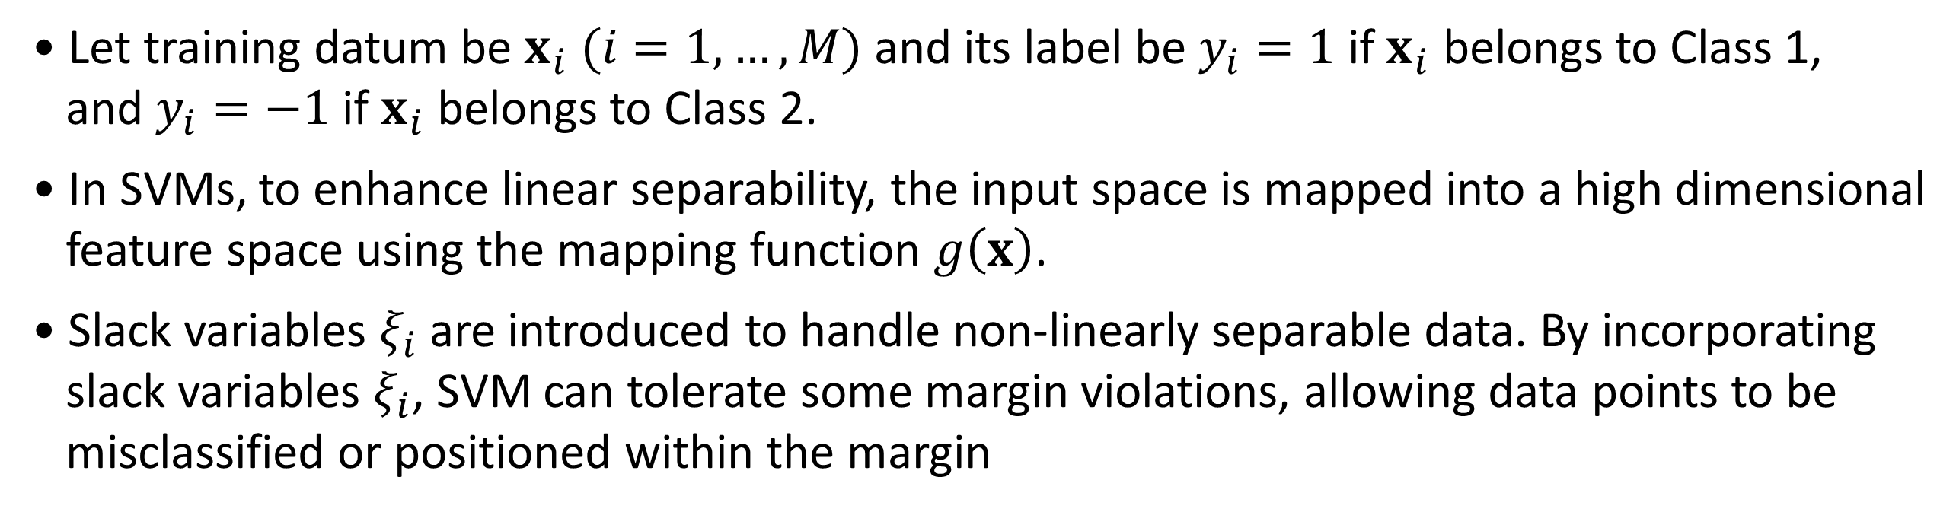
2. L1-SVMs and L2-SVMs
• Let training datum be $x_{i} (i=1,…,M)$ and its label be $y_{i}=1$ if $x_{i}$ belongs to Class 1,
and $y_{i}=−1$ if $x_{i}$ belongs to Class 2.
• In SVMs, to enhance linear separability, the input space is mapped into a high dimensional
feature space using the mapping function $g\left(x\right)$.
• Slack variables $ξ_{i}$ are introduced to handle non-linearly separable data. By incorporating
slack variables $ξ_{i}$, SVM can tolerate some margin violations, allowing data points to be
misclassified or positioned within the margin
05

Slide 6

2. L1-SVMs and L2-SVMs
Role of Slack Variables $ξ_{i}$
• Introducing Tolerance: In reality, data is often not perfectly linearly separable.
A slack variable $ξ_{i}$ represents how much a data point violates the
margin constraints in such cases.
• Optimization Problem: SVM learns the decision boundary by maximizing the margin. Slack
variables modify the optimization problem to include penalties for
margin violations.
• Mathematical Formulation (Soft-Margin SVM Constraints):
$$y_{i}\left(w∙x_{i}+b\right)≥1−ξ_{i}, ξ_{i}≥0, ∀i$$
If $ξ_{i}=0$, the margin constraint is satisfied; if $ξ_{i}>0$, it indicates the extent of the violation.
06

Slide 7
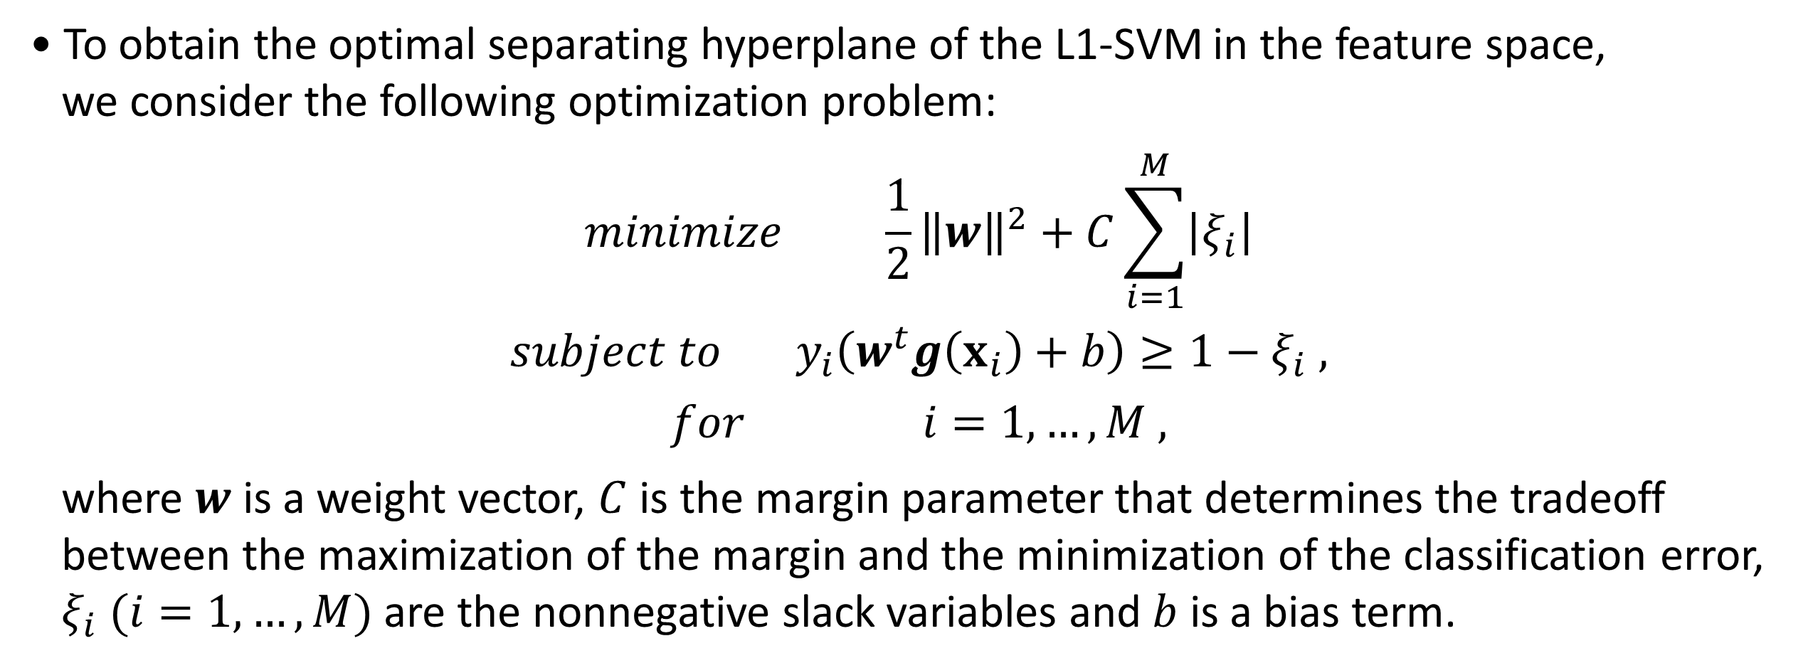
2. L1-SVMs and L2-SVMs
2-1. L1 Support Vector Machines
• To obtain the optimal separating hyperplane of the L1-SVM in the feature space,
we consider the following optimization problem:
$$minimize \frac{1}{2}{\left\|w\right\|}^{2}+C\sum_{i=1}^{M}{\left|ξ_{i}\right|}$$
$$subject to y_{i}\left(w^{t}g\left(x_{i}\right)+b\right)≥1−ξ_{i} ,$$
$$for i=1,…,M ,$$
where $w$ is a weight vector, $C$ is the margin parameter that determines the tradeoff
between the maximization of the margin and the minimization of the classification error,
$ξ_{i} (i=1,…,M)$ are the nonnegative slack variables and $b$ is a bias term.
07

Slide 8
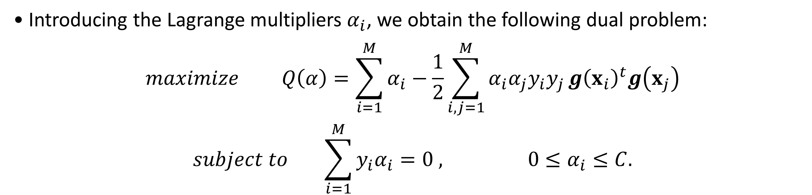
2. L1-SVMs and L2-SVMs
2-1. L1 Support Vector Machines
• Introducing the Lagrange multipliers $α_{i}$, we obtain the following dual problem:
$$maximize Q\left(α\right)=\sum_{i=1}^{M}{α_{i}}−\frac{1}{2}\sum_{i,j=1}^{M}{α_{i}α_{j}y_{i}y_{j}}{g\left(x_{i}\right)}^{t}g\left(x_{j}\right)$$
$$subject to \sum_{i=1}^{M}{y_{i}α_{i}}=0 , 0≤α_{i}≤C.$$
08

Slide 9
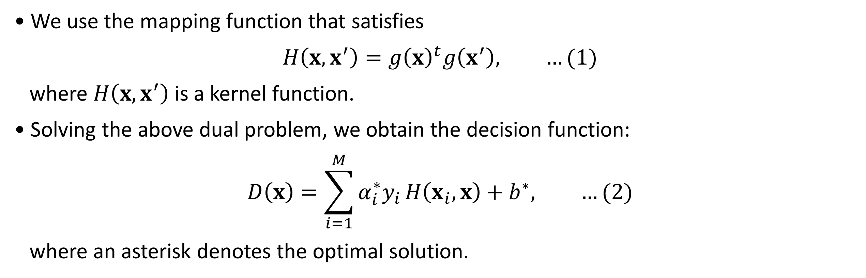
2. L1-SVMs and L2-SVMs
2-1. L1 Support Vector Machines
• We use the mapping function that satisfies
$$H\left(x, x^{′}\right)={g\left(x\right)}^{t}g\left(x^{′}\right), …(1)$$
where $H\left(x, x^{′}\right)$ is a kernel function.
• Solving the above dual problem, we obtain the decision function:
$$D\left(x\right)=\sum_{i=1}^{M}{α_{i}^{∗}y_{i}}H\left(x_{i},x\right)+b^{∗}, …(2)$$
where an asterisk denotes the optimal solution.
09

Slide 10
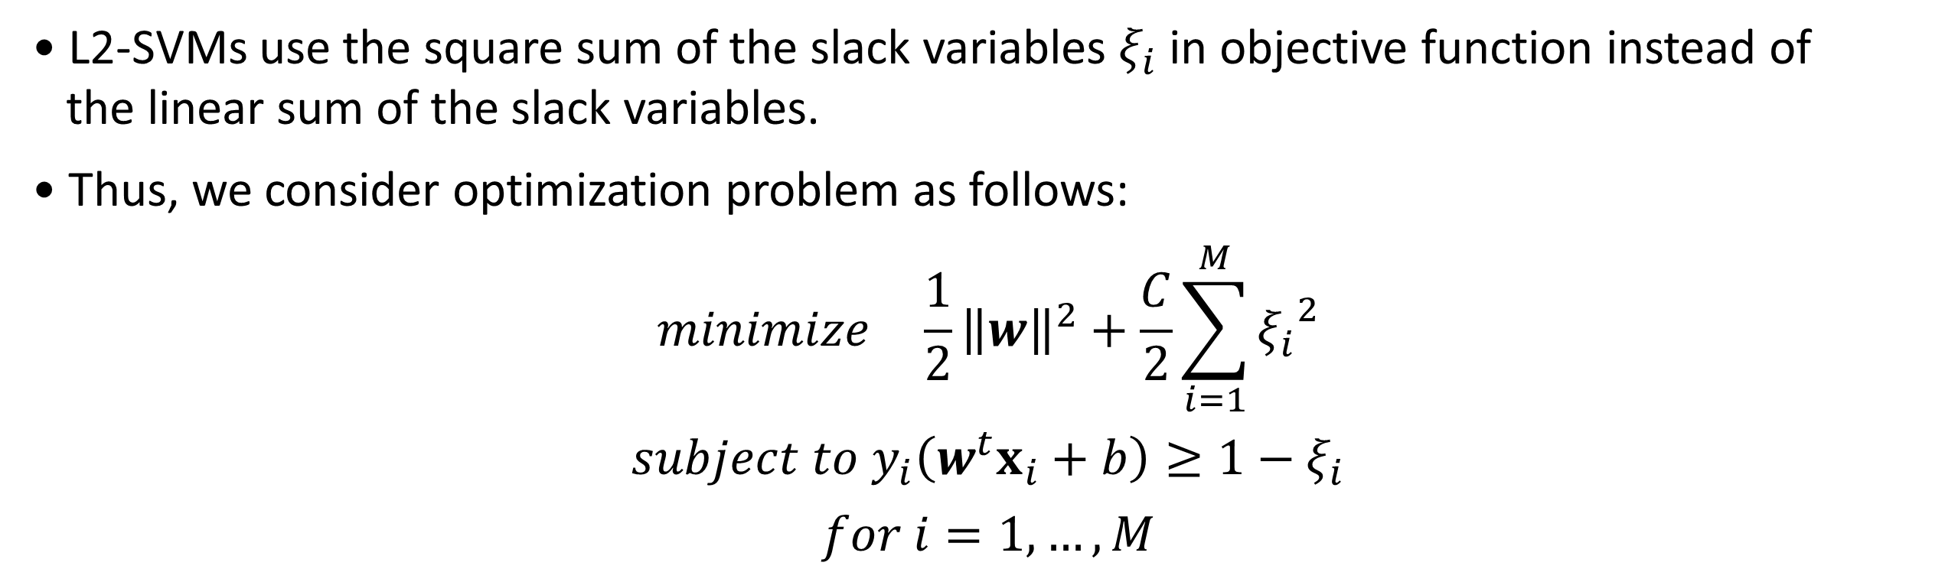
2. L1-SVMs and L2-SVMs
2-2. L2 Support Vector Machines
• L2-SVMs use the square sum of the slack variables $ξ_{i}$ in objective function instead of
the linear sum of the slack variables.
• Thus, we consider optimization problem as follows:
$$minimize \frac{1}{2}{\left\|w\right\|}^{2}+\frac{C}{2}\sum_{i=1}^{M}{{ξ_{i}}^{2}}$$
$$subject to y_{i}\left(w^{t}x_{i}+b\right)≥1−ξ_{i}$$
$$for i=1,…,M$$
10

Slide 11
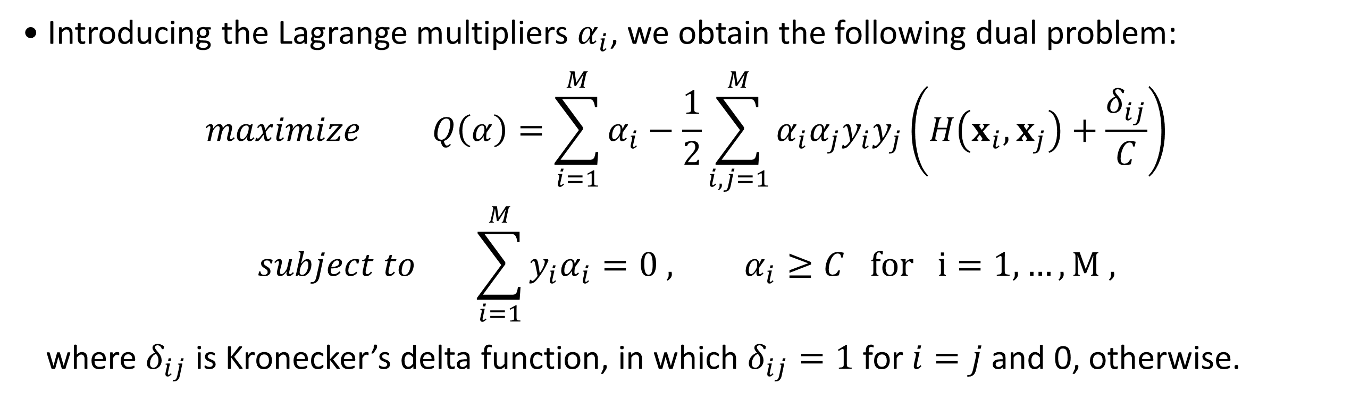
2. L1-SVMs and L2-SVMs
2-2. L2 Support Vector Machines
• Introducing the Lagrange multipliers $α_{i}$, we obtain the following dual problem:
$$maximize Q\left(α\right)=\sum_{i=1}^{M}{α_{i}}−\frac{1}{2}\sum_{i,j=1}^{M}{α_{i}α_{j}y_{i}y_{j}}\left(H\left(x_{i}, x_{j}\right)+\frac{δ_{ij}}{C}\right)$$
$$subject to \sum_{i=1}^{M}{y_{i}α_{i}}=0 , α_{i}≥C for i=1,…,M ,$$
where $δ_{ij}$ is Kronecker’s delta function, in which $δ_{ij}=1$ for $i=j$ and 0, otherwise.
11

Slide 12
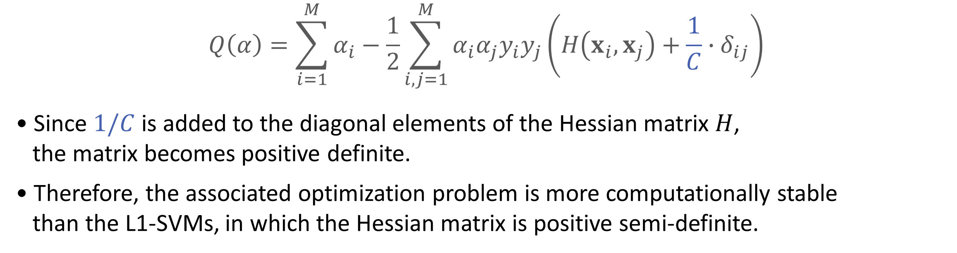
2. L1-SVMs and L2-SVMs
2-2. L2 Support Vector Machines
$$Q\left(α\right)=\sum_{i=1}^{M}{α_{i}}−\frac{1}{2}\sum_{i,j=1}^{M}{α_{i}α_{j}y_{i}y_{j}}\left(H\left(x_{i}, x_{j}\right)+\frac{1}{C}∙δ_{ij}\right)$$
• Since $1/C$ is added to the diagonal elements of the Hessian matrix $H$,
the matrix becomes positive definite.
• Therefore, the associated optimization problem is more computationally stable
than the L1-SVMs, in which the Hessian matrix is positive semi-definite.
12

Slide 13

2. L1-SVMs and L2-SVMs
2-3. L1-SVMs Vs L2-SVMs
$$D\left(x\right)=\sum_{i=1}^{M}{α_{i}^{∗}y_{i}}H\left(x_{i},x\right)+b^{∗}$$
$$Q\left(α\right)=\sum_{i=1}^{M}{α_{i}}−\frac{1}{2}\sum_{i,j=1}^{M}{α_{i}α_{j}y_{i}y_{j}}\left(H\left(x_{i}, x_{j}\right)+\frac{1}{C}∙δ_{ij}\right)$$
• The maximum rank of the Hessian matrix for L1-SVMs is the number of input variables
plus 1.
• Thus, if the working set size exceeds this value, the Hessian matrix for L1-SVMs is positive
semi-definite. But the Hessian matrix for L2-SVMs is always positive definite.
• Thus, training of L2-SVMs should be faster than that of L1-SVMs.^{[1]}
13
[1] Comparison of L1 and L2 Support Vector Machines (2003)

Slide 14
3. Limitations of L1-SVMs and L2-SVMs
3-1. L1-SVMs
• L1-SVM is less sensitive to outliers compared to L2-SVM because it uses the L1-norm
in its loss function.
• However, it often leads to sparse solutions, meaning that only a subset of the data points
(support vectors) contribute to defining the decision boundary.
• While sparsity can be beneficial for reducing model complexity, it might not fully utilize
the information in the data, especially in cases where non-sparse solutions are more
effective.
14

Slide 15
3. Limitations of L1-SVMs and L2-SVMs
3-2. L2-SVMs
• L2-SVM is more sensitive to outliers because it uses the squared error (L2-norm), which
amplifies the impact of large residuals.
• On the other hand, this approach can result in better generalization performance in
situations where outliers are not a significant concern.
• However, when outliers are present, the decision boundary may be distorted, leading to
reduced classification accuracy.
15

Slide 16
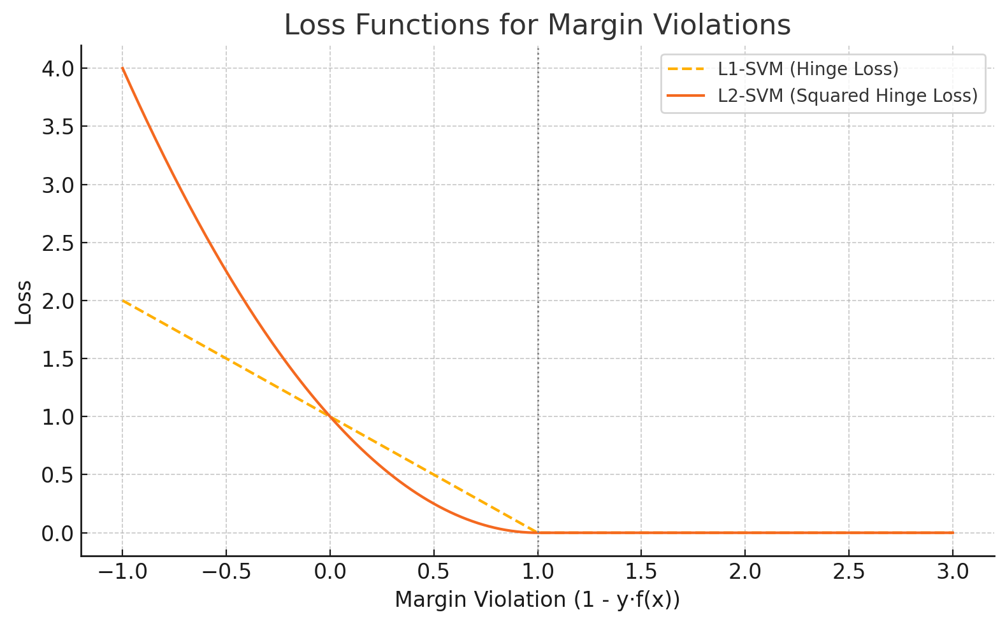
3. Limitations of L1-SVMs and L2-SVMs
3-3. The Importance for Robustness in SVM
• Standard SVM models, including both L1 and L2 variants, are vulnerable to outliers,
especially in datasets with significant noise.
16
Notes:
L1-SVM imposes a linear penalty for margin violations, while L2-SVM uses a squared penalty, making it even more sensitive to large errors

Slide 17
3. Limitations of L1-SVMs and L2-SVMs
3-3. The Importance for Robustness in SVM
• To address this limitation, our study proposes a framework that integrates M-estimation-
based loss functions, which limit the influence of large errors and enhance robustness
without compromising classification performance.
17

Slide 18
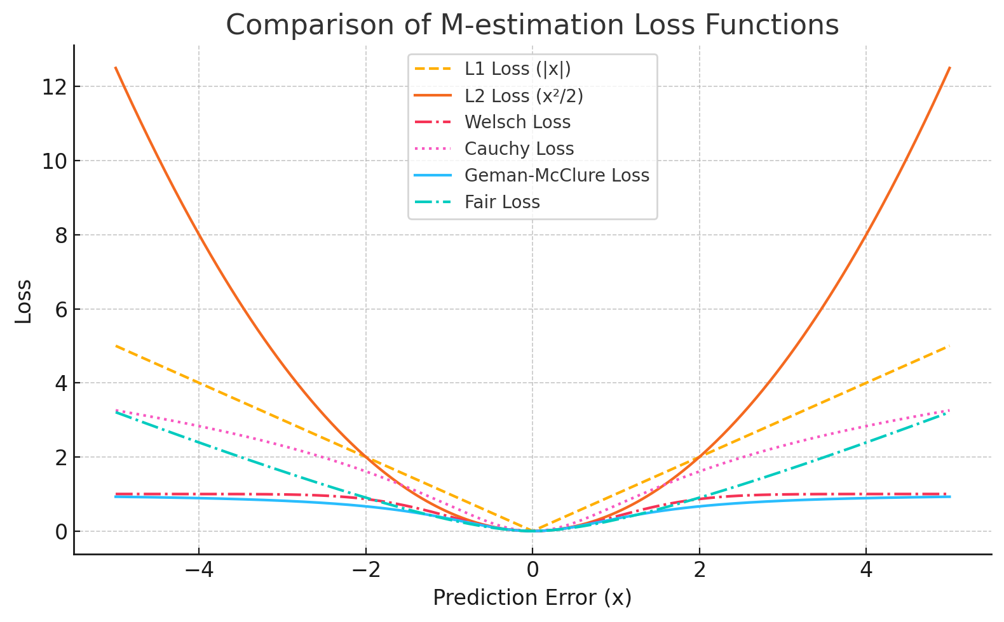
3. Limitations of L1-SVMs and L2-SVMs
3-3. The Importance for Robustness in SVM
• Unlike L1 and L2 loss, M-estimation loss suppress the impact of large errors, making the
model more robust to outliers.
18

Slide 19
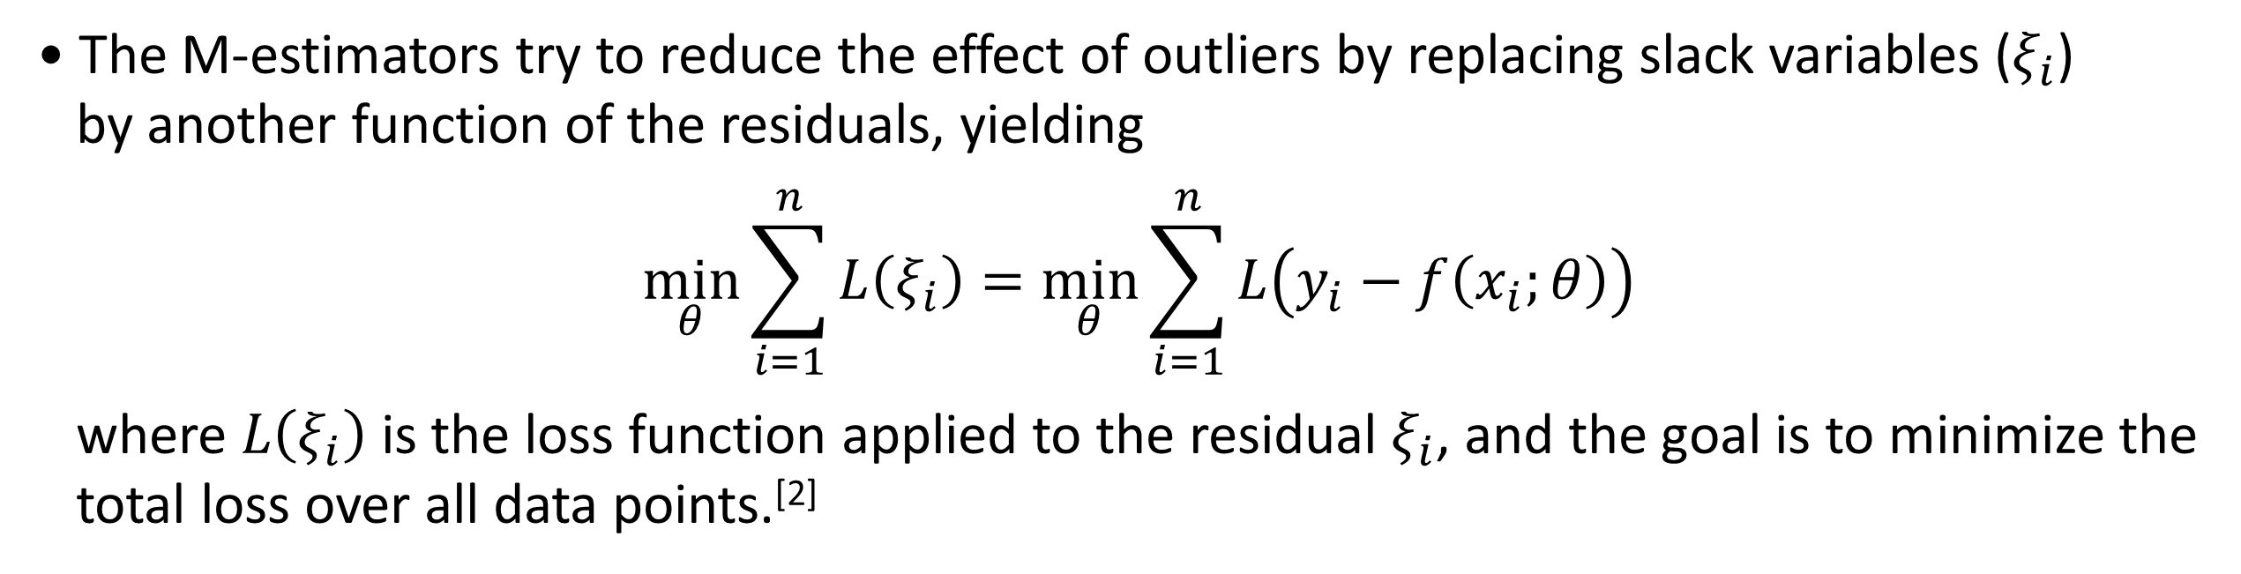
4. M-Estimator-based SVM
• The M-estimators try to reduce the effect of outliers by replacing slack variables ($ξ_{i}$)
by another function of the residuals, yielding
$$\min_{θ}{\sum_{i=1}^{n}{L\left(ξ_{i}\right)}}=\min_{θ}\sum_{i=1}^{n}{L\left(y_{i}−f\left(x_{i};θ\right)\right)}$$
where $L\left(ξ_{i}\right)$ is the loss function applied to the residual $ξ_{i}$, and the goal is to minimize the
total loss over all data points.^{[2]}
19
[2] https://www-sop.inria.fr/odyssee/software/old_robotvis/Tutorial-Estim/node24.html

Slide 20
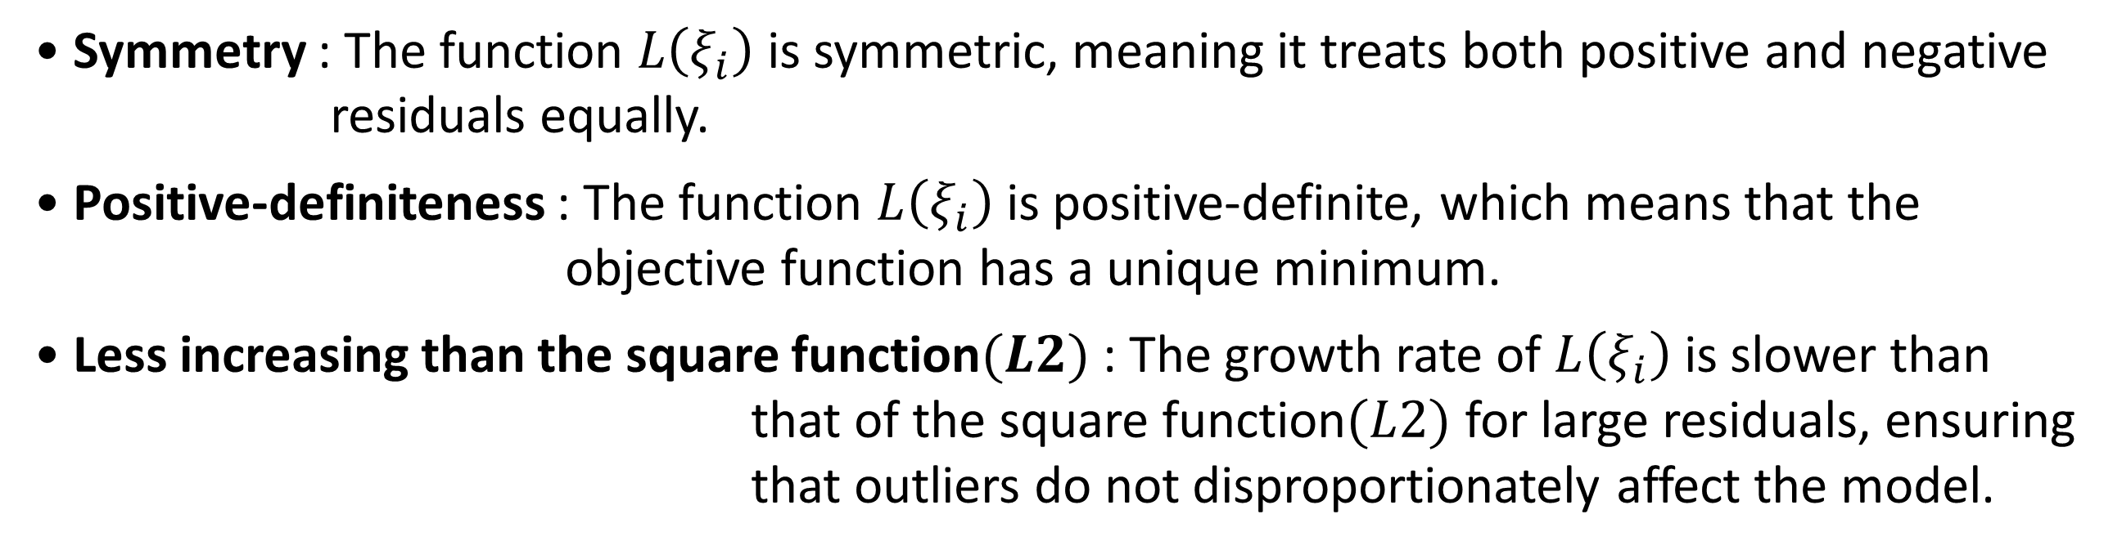
4. M-Estimator-based SVM
Key Features of the M-Estimator’s Loss Function
• Symmetry : The function $L\left(ξ_{i}\right)$ is symmetric, meaning it treats both positive and negative
residuals equally.
• Positive-definiteness : The function $L\left(ξ_{i}\right)$ is positive-definite, which means that the
objective function has a unique minimum.
• Less increasing than the square function$(L2)$ : The growth rate of $L\left(ξ_{i}\right)$ is slower than
that of the square function$(L2)$ for large residuals, ensuring
that outliers do not disproportionately affect the model.
20

Slide 21
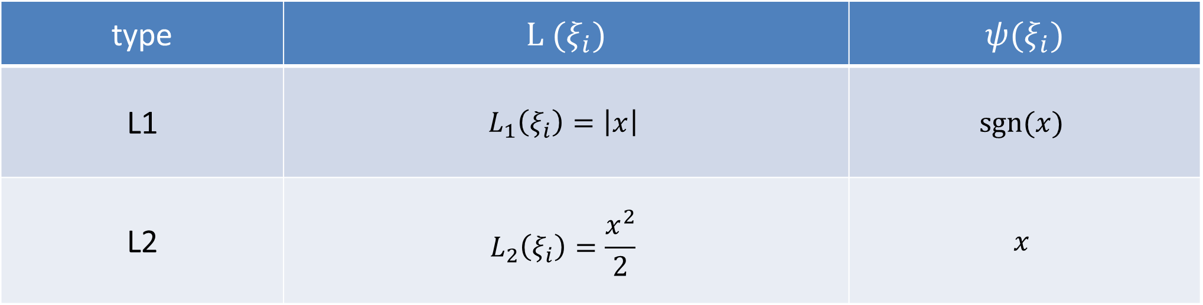
4. M-Estimator-based SVM
Loss Functions of type L1 and type L2
type | $$L (ξ_{i})$$ | $$ψ(ξ_{i})$$
L1 | $$L_{1}\left(ξ_{i}\right)=\left|x\right|$$ | $$sgn⁡(x)$$
L2 | $$L_{2}\left(ξ_{i}\right)=\frac{x^{2}}{2}$$ | $$x$$
21

Slide 22
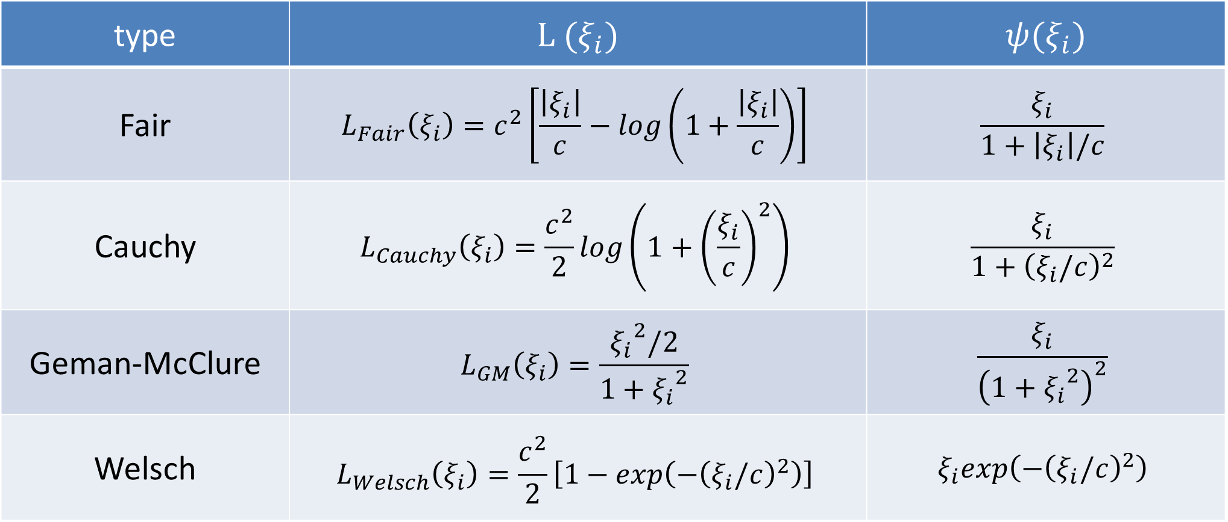
4. M-Estimator-based SVM
Some examples of common functions used in M-Estimators
type | $$L (ξ_{i})$$ | $$ψ(ξ_{i})$$
Fair | $$L_{Fair}\left(ξ_{i}\right)=c^{2}\left[\frac{\left|ξ_{i}\right|}{c}−log\left(1+\frac{\left|ξ_{i}\right|}{c}\right)\right]$$ | $$\frac{ξ_{i}}{1+\left|ξ_{i}\right|/c}$$
Cauchy | $$L_{Cauchy}\left(ξ_{i}\right)=\frac{c^{2}}{2}log⁡\left(1+{\left(\frac{ξ_{i}}{c}\right)}^{2}\right)$$ | $$\frac{ξ_{i}}{1+{\left(ξ_{i}/c\right)}^{2}}$$
Geman-McClure | $$L_{GM}\left(ξ_{i}\right)=\frac{{ξ_{i}}^{2}/2}{1+{ξ_{i}}^{2}}$$ | $$\frac{ξ_{i}}{{\left(1+{ξ_{i}}^{2}\right)}^{2}}$$
Welsch | $$L_{Welsch}\left(ξ_{i}\right)=\frac{c^{2}}{2}\left[1−exp\left(−{\left(ξ_{i}/c\right)}^{2}\right)\right]$$ | $$ξ_{i}exp\left(−{\left(ξ_{i}/c\right)}^{2}\right)$$
22

Slide 23
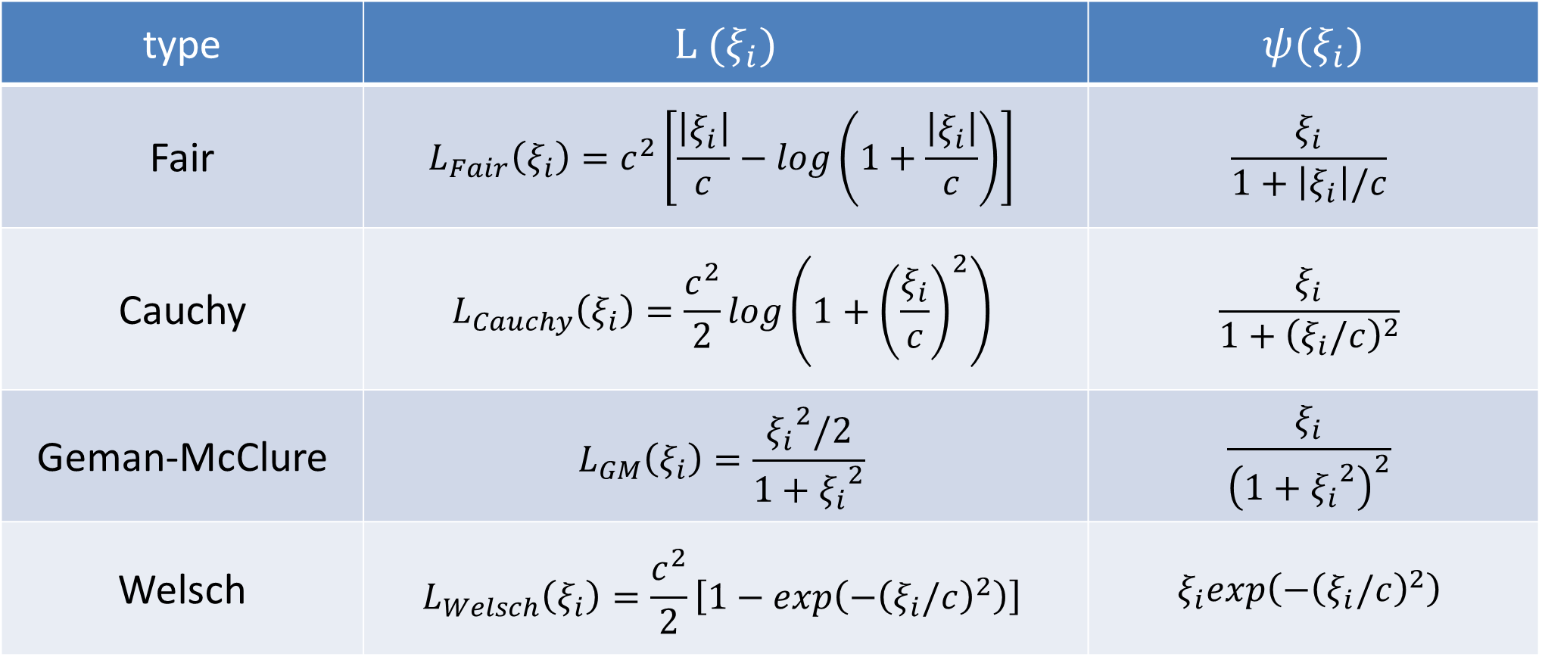
4. M-Estimator-based SVM
type | $$L (ξ_{i})$$ | $$ψ(ξ_{i})$$
Fair | $$L_{Fair}\left(ξ_{i}\right)=c^{2}\left[\frac{\left|ξ_{i}\right|}{c}−log\left(1+\frac{\left|ξ_{i}\right|}{c}\right)\right]$$ | $$\frac{ξ_{i}}{1+\left|ξ_{i}\right|/c}$$
Cauchy | $$L_{Cauchy}\left(ξ_{i}\right)=\frac{c^{2}}{2}log⁡\left(1+{\left(\frac{ξ_{i}}{c}\right)}^{2}\right)$$ | $$\frac{ξ_{i}}{1+{\left(ξ_{i}/c\right)}^{2}}$$
Geman-McClure | $$L_{GM}\left(ξ_{i}\right)=\frac{{ξ_{i}}^{2}/2}{1+{ξ_{i}}^{2}}$$ | $$\frac{ξ_{i}}{{\left(1+{ξ_{i}}^{2}\right)}^{2}}$$
Welsch | $$L_{Welsch}\left(ξ_{i}\right)=\frac{c^{2}}{2}\left[1−exp\left(−{\left(ξ_{i}/c\right)}^{2}\right)\right]$$ | $$ξ_{i}exp\left(−{\left(ξ_{i}/c\right)}^{2}\right)$$
• These loss functions are not ‘robust’ in themselves, but they are designed to produce
robust M-estimators by reducing the impact of outliers in the estimation process.
23

Slide 24
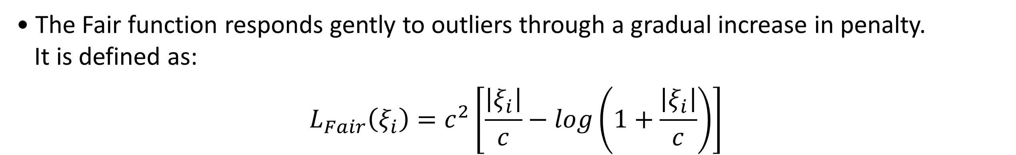
4. M-Estimator-based SVM
4-1. Type Fair-SVMs
• The Fair function responds gently to outliers through a gradual increase in penalty.
It is defined as:
$$L_{Fair}\left(ξ_{i}\right)=c^{2}\left[\frac{\left|ξ_{i}\right|}{c}−log\left(1+\frac{\left|ξ_{i}\right|}{c}\right)\right]$$
24

Slide 25
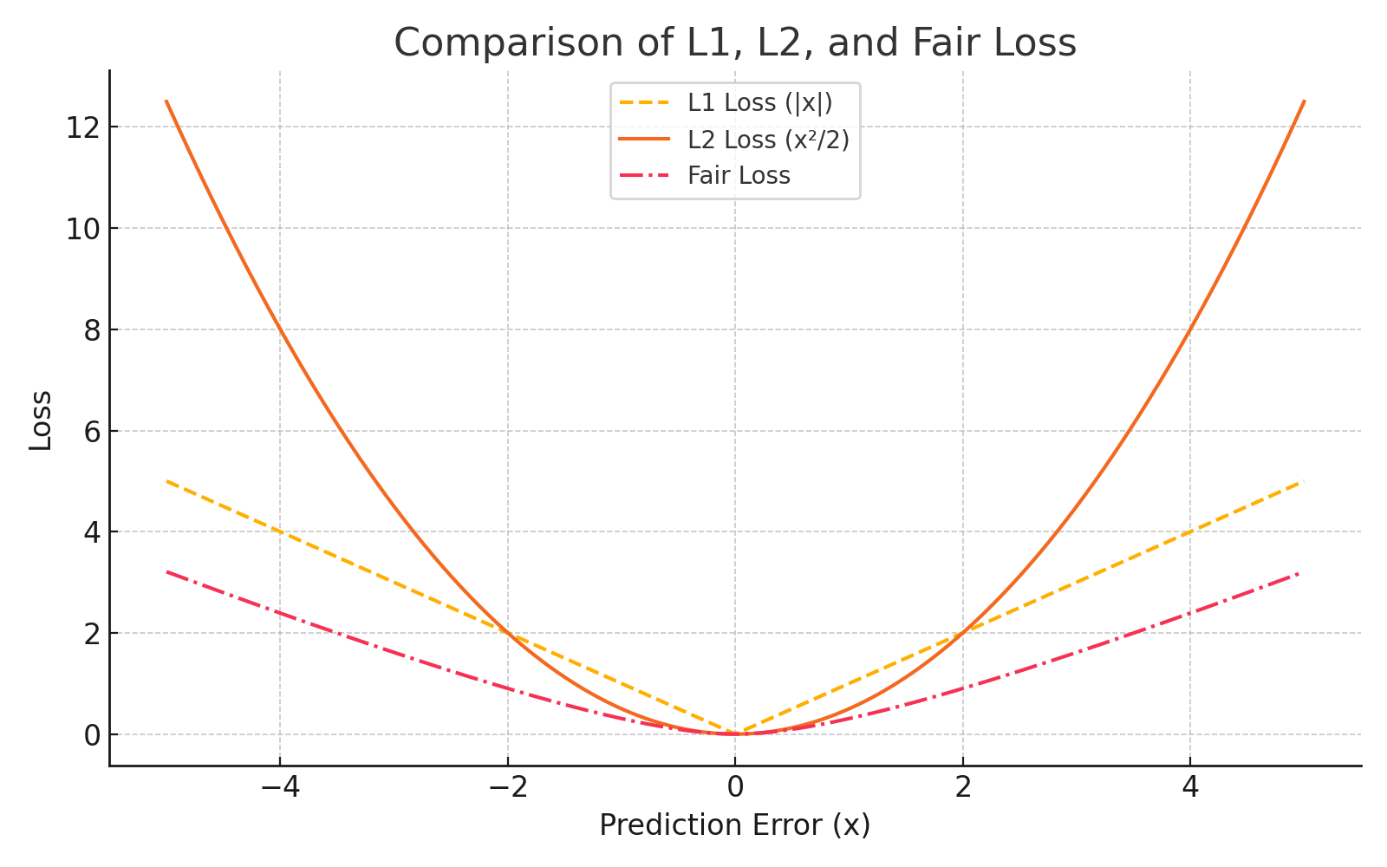
4. M-Estimator-based SVM
4-1. Type Fair-SVMs
• Fair Loss reduces the influence of large errors and yields a more robust M-estimator
than L1 or L2
25

Slide 26
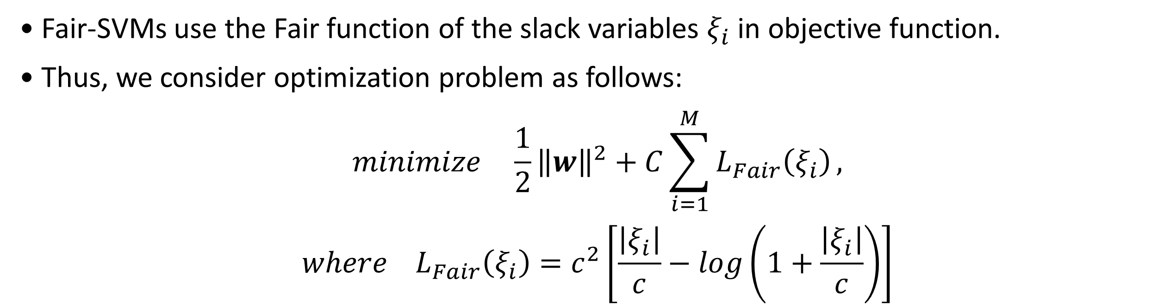
4. M-Estimator-based SVM
4-1. Type Fair-SVMs
• Fair-SVMs use the Fair function of the slack variables $ξ_{i}$ in objective function.
• Thus, we consider optimization problem as follows:
$$minimize \frac{1}{2}{\left\|w\right\|}^{2}+C\sum_{i=1}^{M}{L_{Fair}\left(ξ_{i}\right)},$$
$$where L_{Fair}\left(ξ_{i}\right)=c^{2}\left[\frac{\left|ξ_{i}\right|}{c}−log\left(1+\frac{\left|ξ_{i}\right|}{c}\right)\right]$$
26

Slide 27
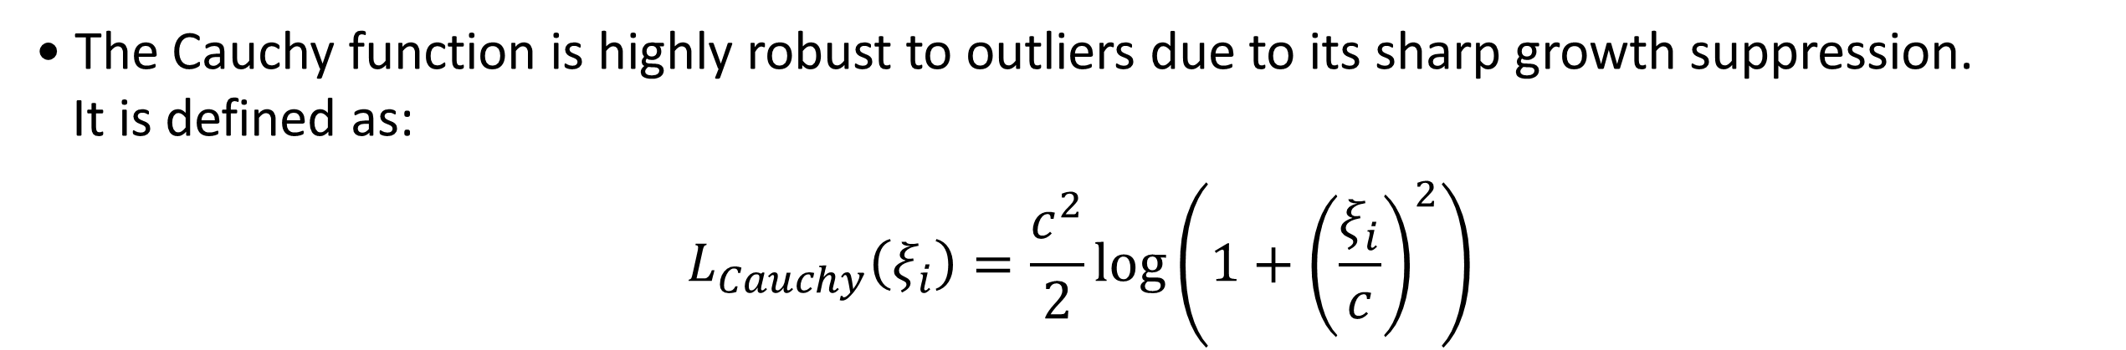
4. M-Estimator-based SVM
4-2. Type Cauchy-SVMs
• The Cauchy function is highly robust to outliers due to its sharp growth suppression.
It is defined as:
$$L_{Cauchy}\left(ξ_{i}\right)=\frac{c^{2}}{2}log⁡\left(1+{\left(\frac{ξ_{i}}{c}\right)}^{2}\right)$$
27

Slide 28
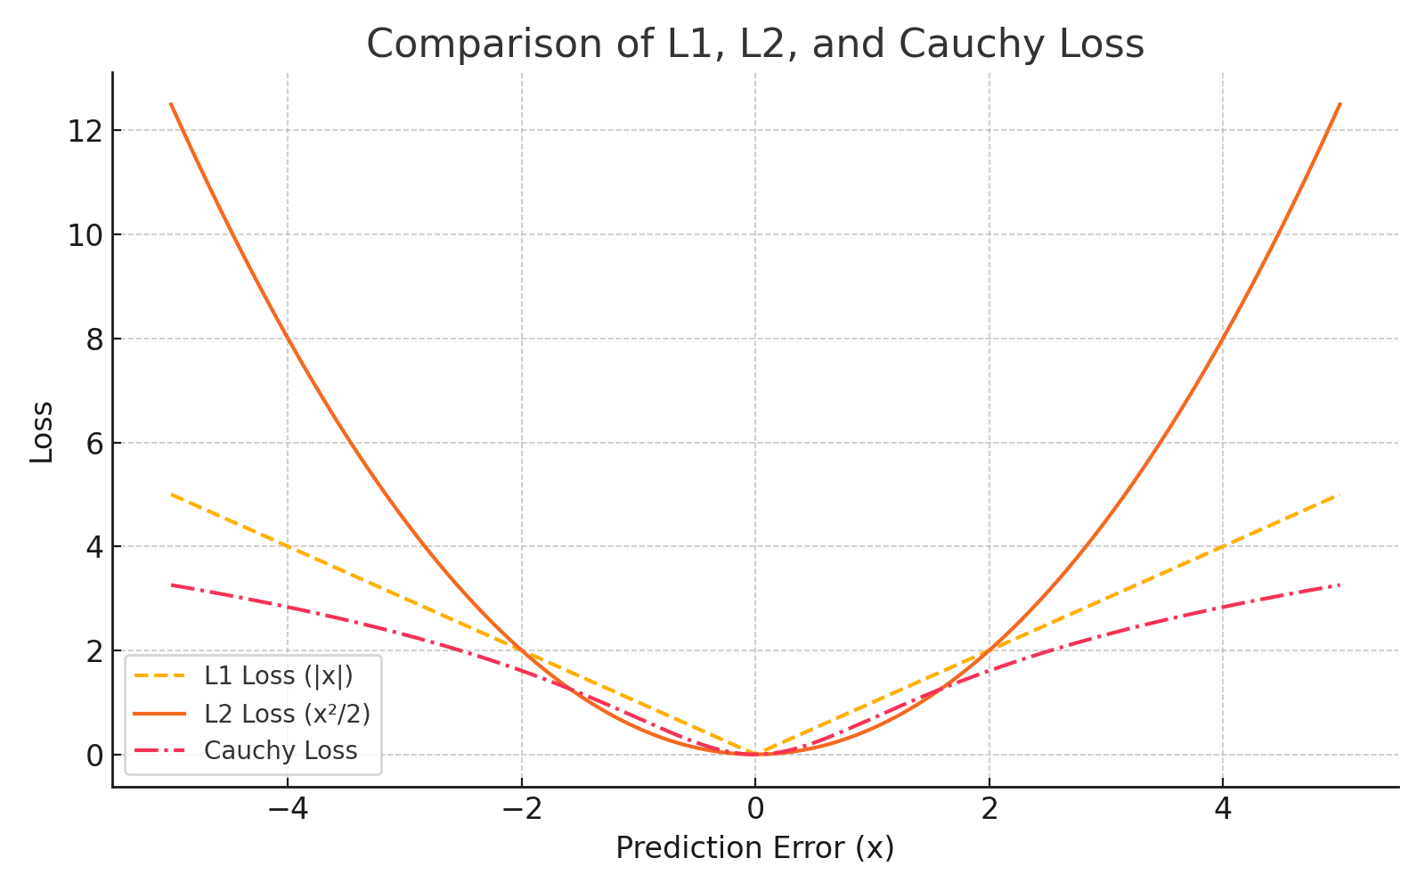
4. M-Estimator-based SVM
4-2. Type Cauchy-SVMs
• Cauchy Loss grows slowly for large errors, providing a robust M-estimator that suppresses
outlier influence.
28

Slide 29
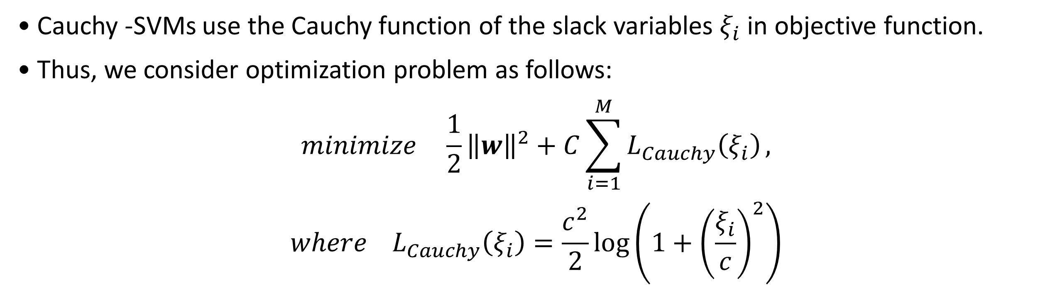
4. M-Estimator-based SVM
4-2. Type Cauchy-SVMs
• Cauchy -SVMs use the Cauchy function of the slack variables $ξ_{i}$ in objective function.
• Thus, we consider optimization problem as follows:
$$minimize \frac{1}{2}{\left\|w\right\|}^{2}+C\sum_{i=1}^{M}{L_{Cauchy}\left(ξ_{i}\right)},$$
$$where L_{Cauchy}\left(ξ_{i}\right)=\frac{c^{2}}{2}log⁡\left(1+{\left(\frac{ξ_{i}}{c}\right)}^{2}\right)$$
29

Slide 30
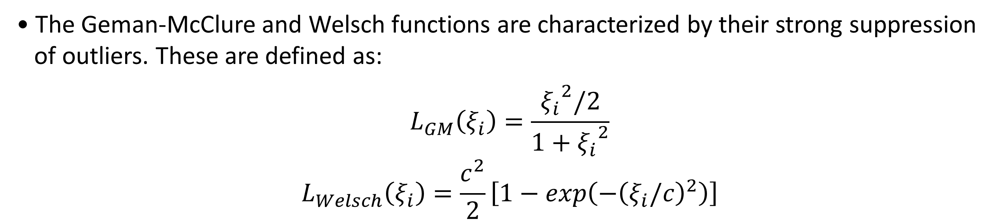
4. M-Estimator-based SVM
4-3. Type Geman-McClure, Welsch-SVMs
• The Geman-McClure and Welsch functions are characterized by their strong suppression
of outliers. These are defined as:
$$L_{GM}\left(ξ_{i}\right)=\frac{{ξ_{i}}^{2}/2}{1+{ξ_{i}}^{2}}$$
$$L_{Welsch}\left(ξ_{i}\right)=\frac{c^{2}}{2}\left[1−exp\left(−{\left(ξ_{i}/c\right)}^{2}\right)\right]$$
30

Slide 31
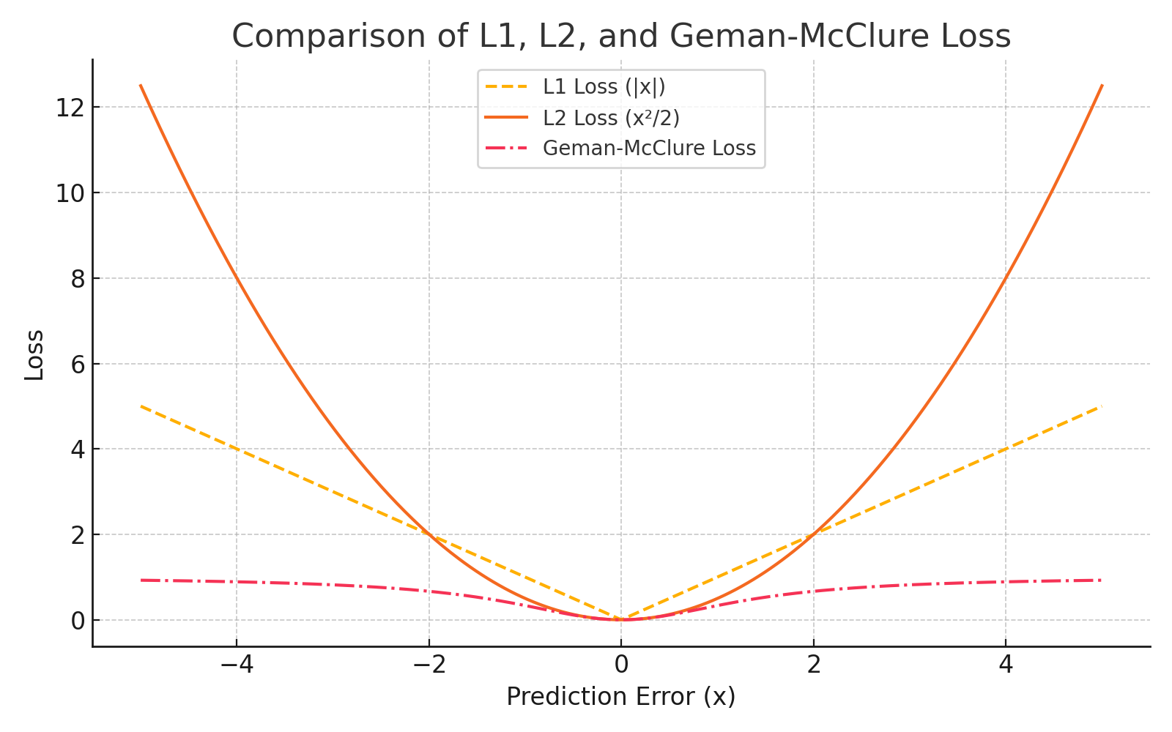
4. M-Estimator-based SVM
4-3. Type Geman-McClure, Welsch-SVMs
• Geman-McClure Loss flattens after an initial increase, yielding M-estimators that are
robust yet responsive to moderate errors.
31

Slide 32
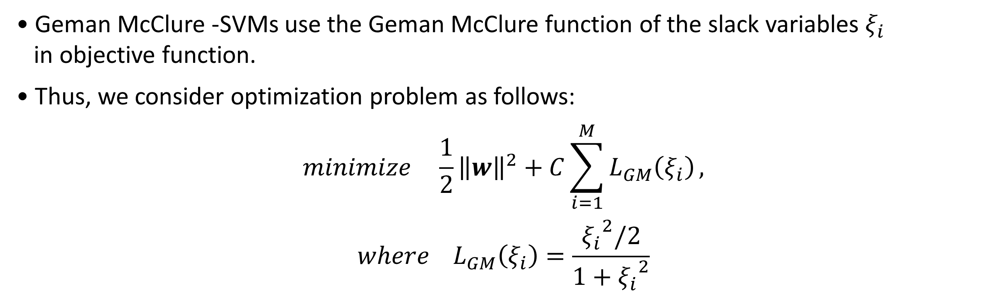
4. M-Estimator-based SVM
4-3. Type Geman-McClure-SVMs
• Geman McClure -SVMs use the Geman McClure function of the slack variables $ξ_{i}$
in objective function.
• Thus, we consider optimization problem as follows:
$$minimize \frac{1}{2}{\left\|w\right\|}^{2}+C\sum_{i=1}^{M}{L_{GM}\left(ξ_{i}\right)},$$
$$where L_{GM}\left(ξ_{i}\right)=\frac{{ξ_{i}}^{2}/2}{1+{ξ_{i}}^{2}}$$
32

Slide 33
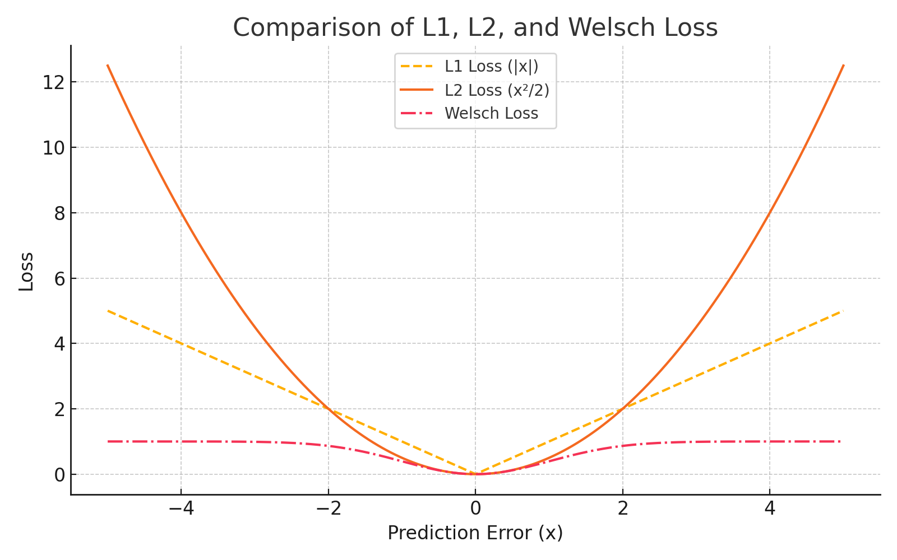
4. M-Estimator-based SVM
4-4. Type Welsch-SVMs
• Welsch Loss saturates as the error increases, producing highly robust M-estimators by
effectively ignoring outliers.
33

Slide 34
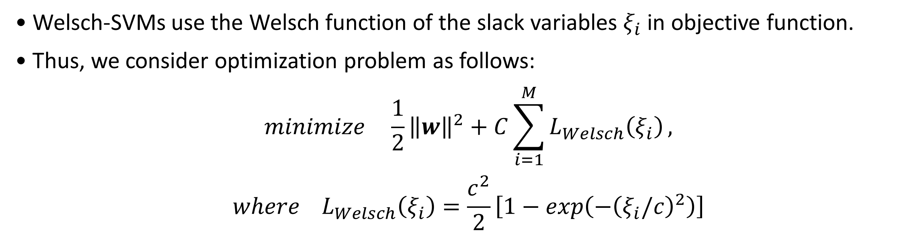
4. M-Estimator-based SVM
4-4. Type Welsch-SVMs
• Welsch-SVMs use the Welsch function of the slack variables $ξ_{i}$ in objective function.
• Thus, we consider optimization problem as follows:
$$minimize \frac{1}{2}{\left\|w\right\|}^{2}+C\sum_{i=1}^{M}{L_{Welsch}\left(ξ_{i}\right)},$$
$$where L_{Welsch}\left(ξ_{i}\right)=\frac{c^{2}}{2}\left[1−exp\left(−{\left(ξ_{i}/c\right)}^{2}\right)\right]$$
34

Slide 35
5. Data Analysis
• Objective
The main objective of our experiments is to evaluate the robustness and performance of
M-estimation-based SVM models under noisy and outlier-contaminated conditions.
We also compare the effects of different optimization algorithms on the classification
performance and efficiency of these models.
• Datasets
We used four publicly available binary classification datasets:
Arrhythmia, Madelon, WBC (Wisconsin Breast Cancer), Ionosphere
To simulate realistic conditions, we introduced synthetic noise and outliers into each
dataset by adding mislabeled instances and injecting extreme values into the feature
space.
35

Slide 36
5. Data Analysis
5-1. Loss Functions (M-estimators)
• Each SVM model was trained using a different loss function derived from M-estimation
theory:
Fair Loss, Cauchy Loss, Welsch Loss, Geman-McClure Loss
For comparison, we also included traditional L1-SVM and L2-SVM models.
36

Slide 37
5. Data Analysis
5-2. Optimization Algorithms
• To explore the influence of optimization techniques, we applied the following algorithms
to solve the SVM objective function with each loss function:
– SMO (Sequential Minimal Optimization)
– GA (Genetic Algorithm)
– PSO (Particle Swarm Optimization)
– ACO (Ant Colony Optimization)
– HS (Harmony Search)
These optimizers were selected to evaluate both conventional (SMO) and global
population-based methods for non-convex loss functions.
37

Slide 38
5. Data Analysis
• Synthetic Data & Outlier Injection
To evaluate robustness under increasing noise, we created a synthetic binary classification
dataset with 200 samples and 2 informative features. Class labels were converted to +1
and -1 for SVM training.
We generate two versions of dataset:
- “One with 1% outliers (baseline)”
- “One with 5% outliers (higher noise level)”
• Evaluation Metric
We used accuracy on a clean test set as the evaluation metric.
Each model was trained on both the 1% and 5% outlier datasets.
We then calculated the accuracy degradation between the two settings to measure how
well each model withstands increased noise and outlier contamination.
38

Slide 39
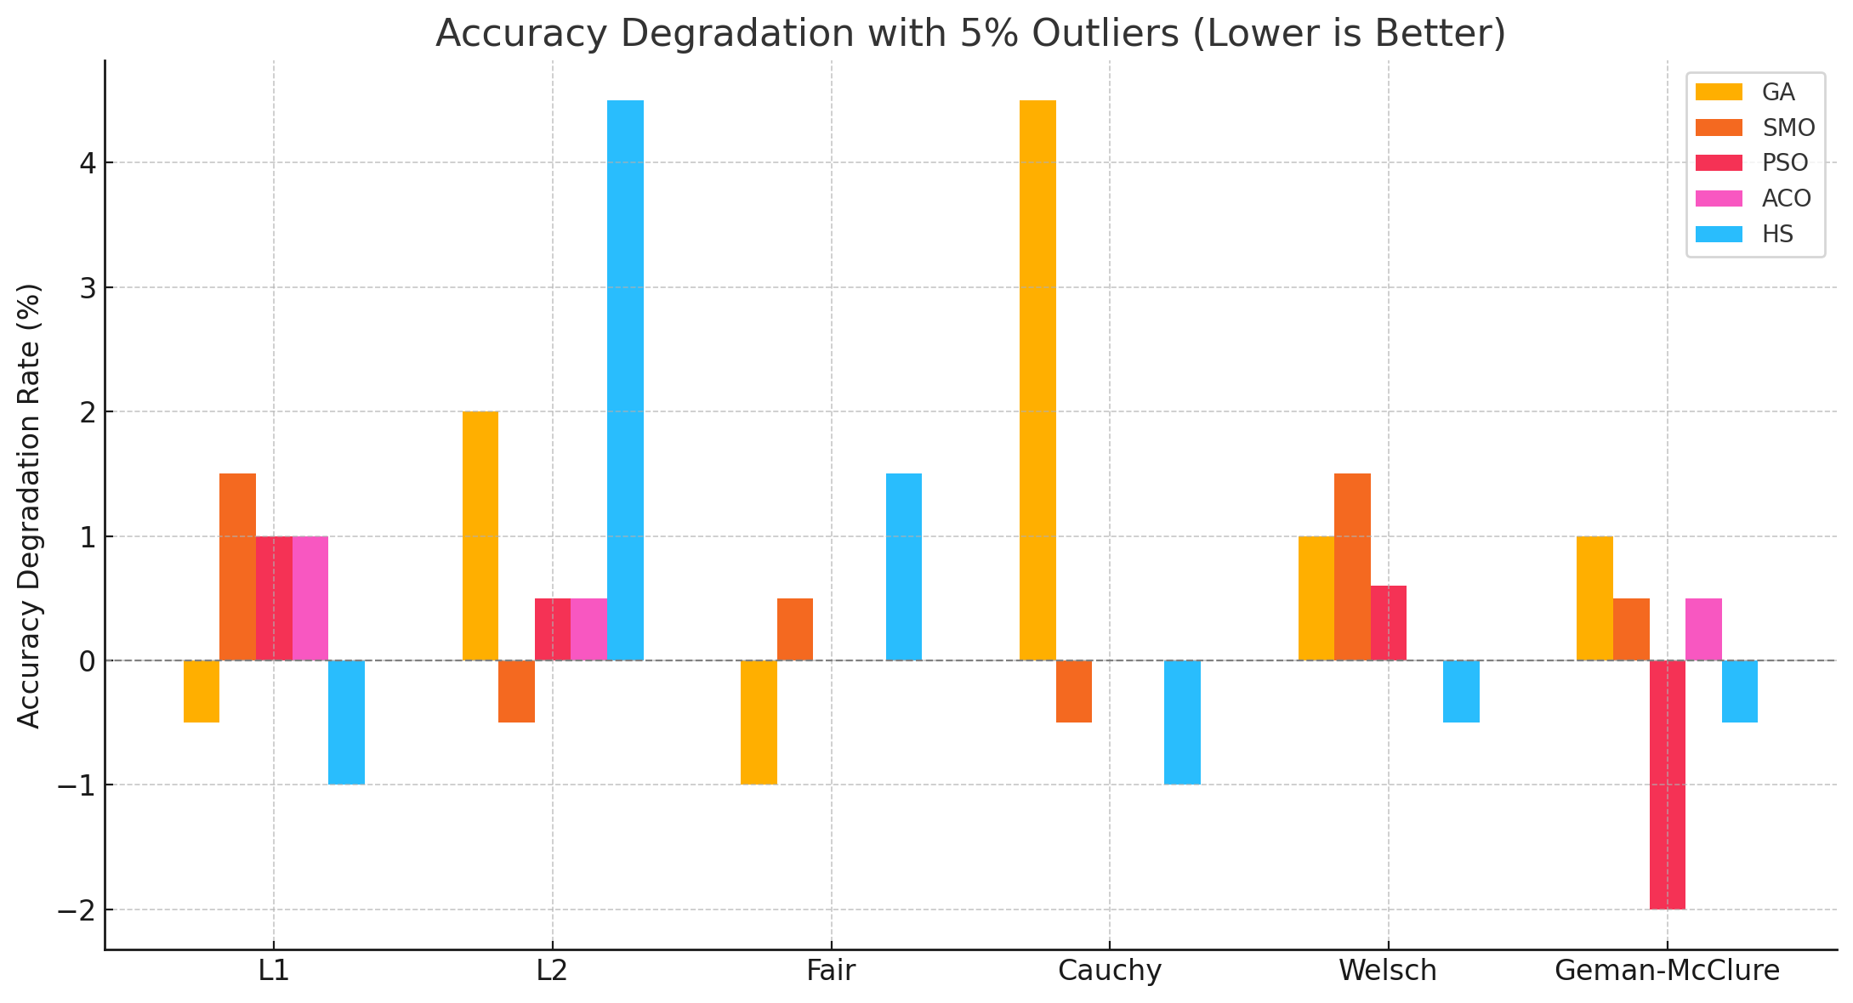
5. Data Analysis
• This chart summarizes how much accuracy dropped – or improved – after injecting 5%
outliers.
As we can see, combinations like ‘PSO+GM’ or ‘HS+Cauchy’ even saw accuracy gains,
highlighting their robustness. In contrast, models like ‘GA+Cauchy’ experienced the largest
degradation, showing greater sensitivity to noise.
39

Slide 40
5. Data Analysis
• In a few cases, the model’s accuracy improved after injecting outliers.
While this might seem like a positive effect, it’s likely due to favorable shifts in the data
distribution.
Therefore, we interpret such improvements cautiously and focus more on minimizing
performance degradation across conditions.
40

Slide 41
5. Data Analysis
Experimental Setting
• 4 binary classification datasets: Arrythmia, Madelon, WBC, Ionosphere
• Each dataset originally contains a small percentage of outliers
• We increased the outlier ratio to 10% by injecting synthetic outliers
• Models: SVMs using M-estimation loss functions
(Fair, Cauchy, Welsch, Geman-McClure) and traditional (L1, L2)
• Optimization methods: GA, SMO, PSO, ACO, HS
• Metric: Accuracy difference from original outlier ratio to 10%
(Lower values -> More robust to outliers)
41

Slide 42
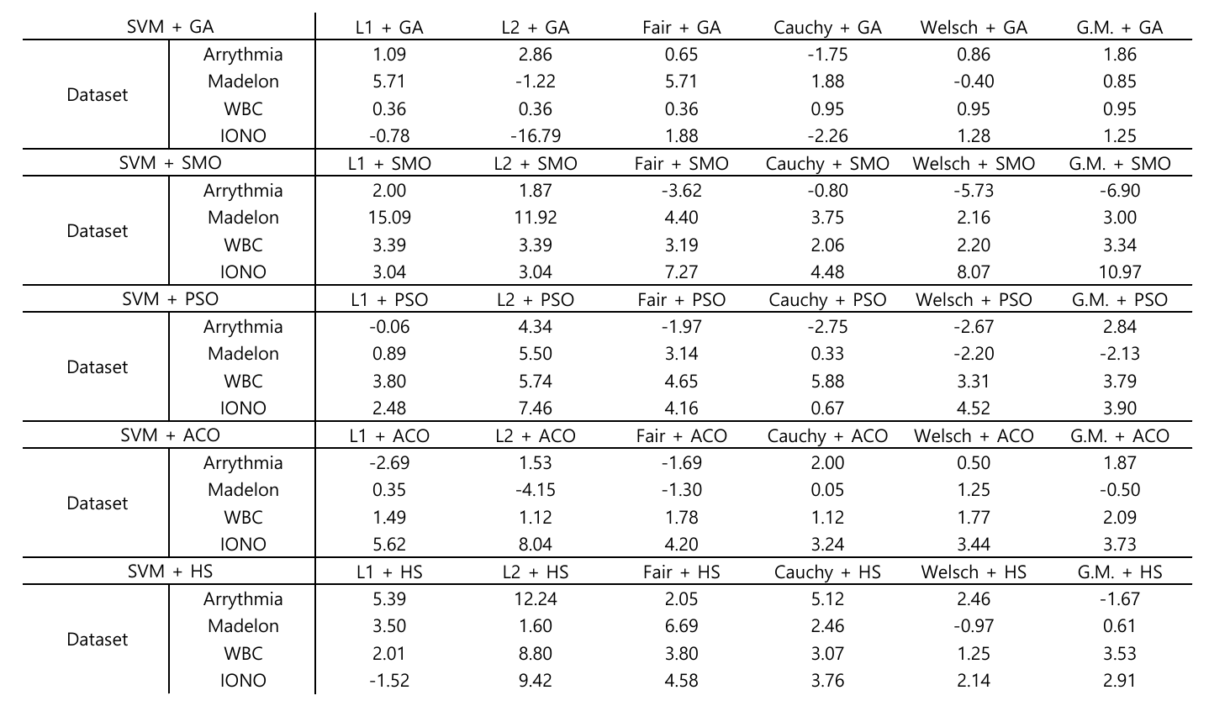
5. Data Analysis
42

Slide 43
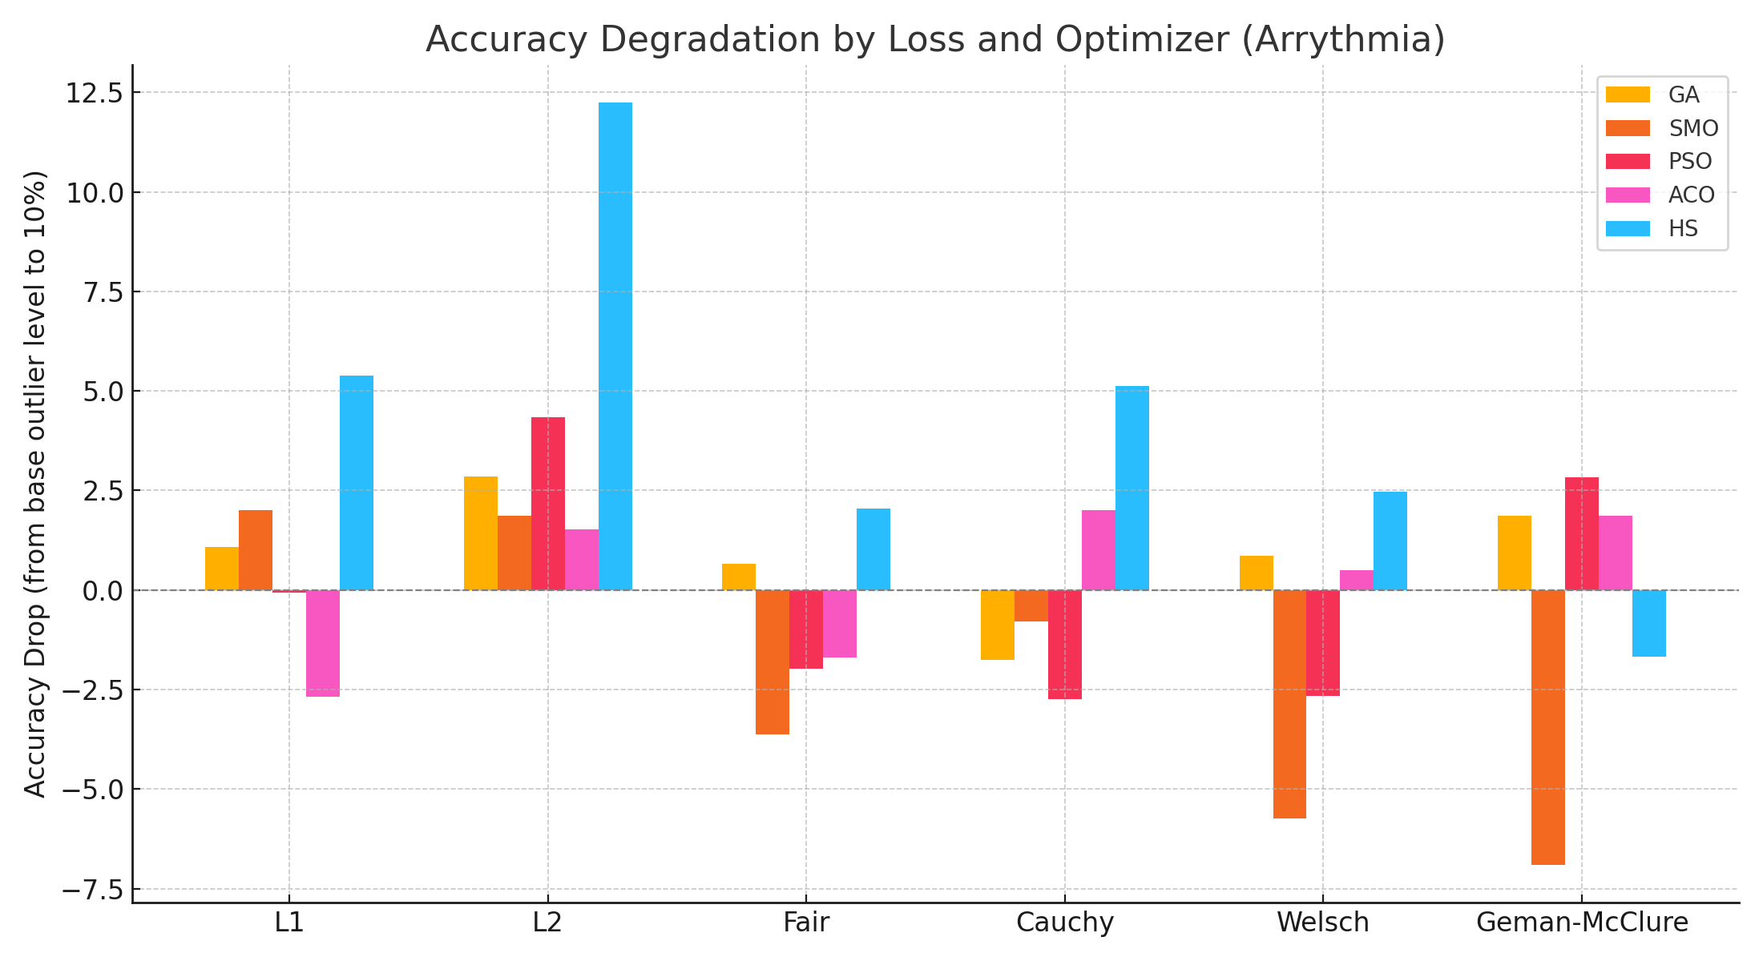
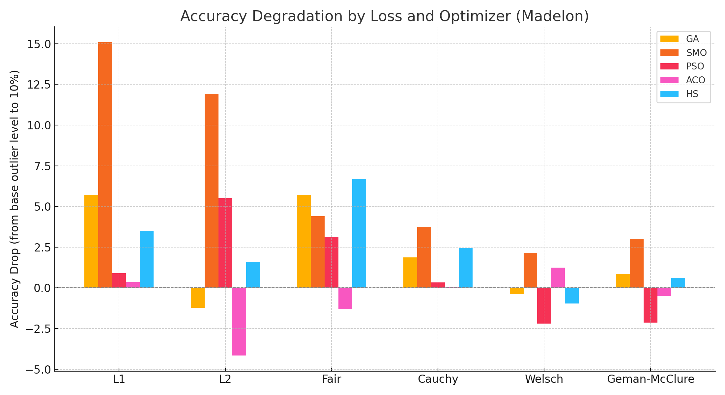
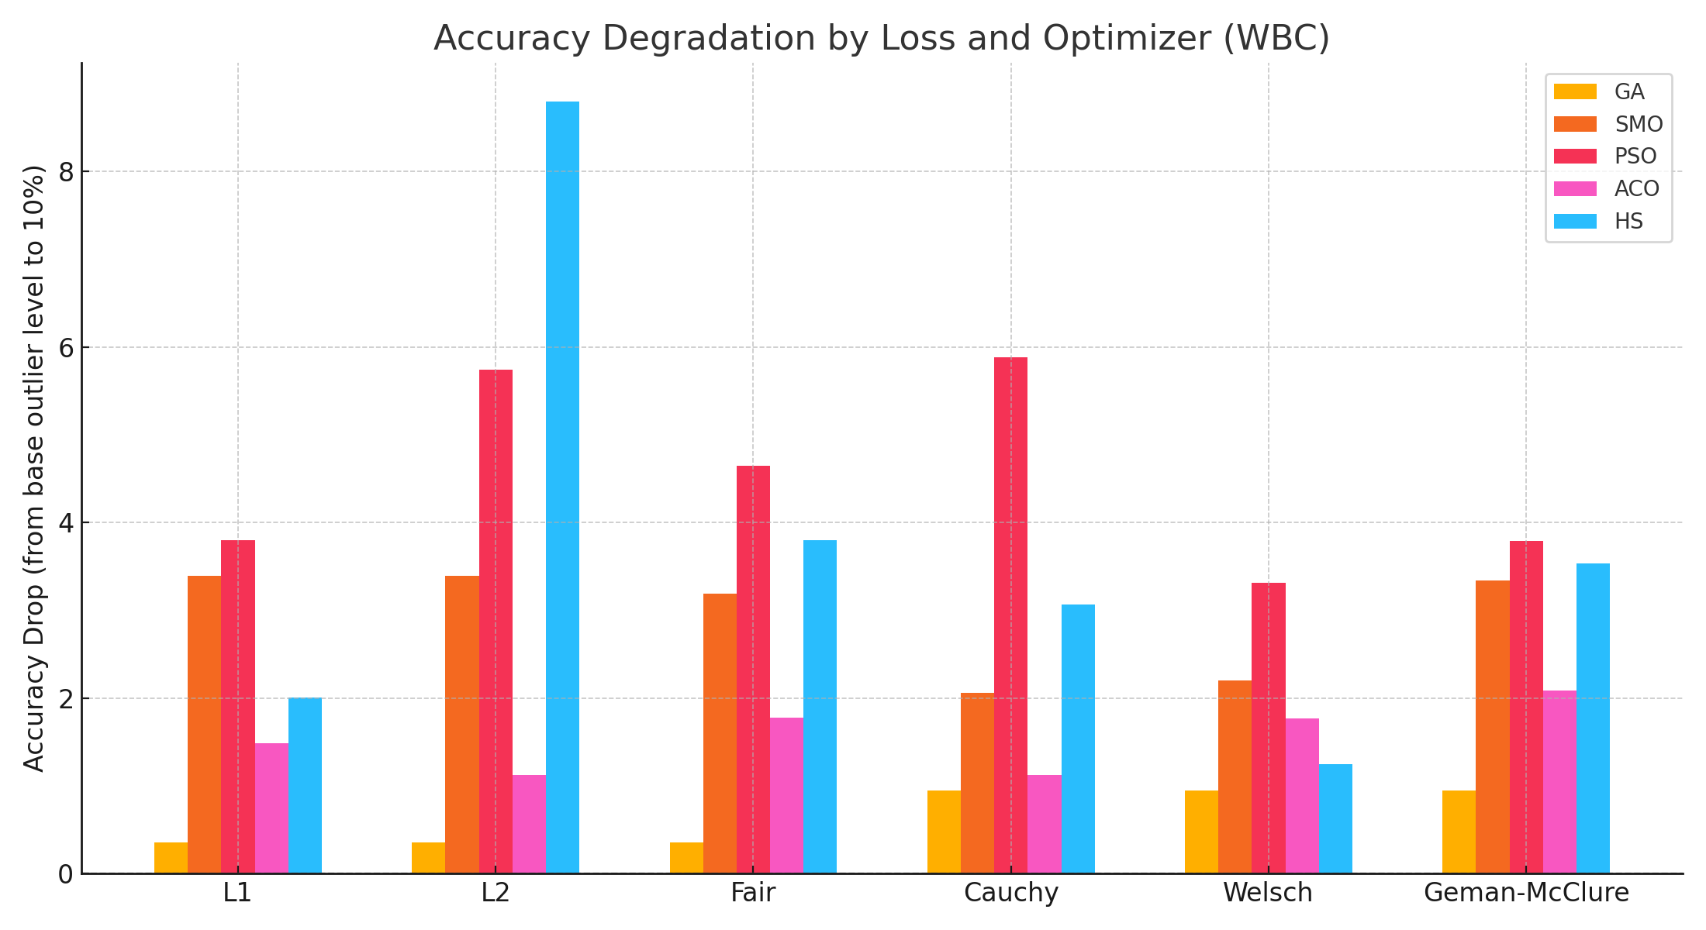
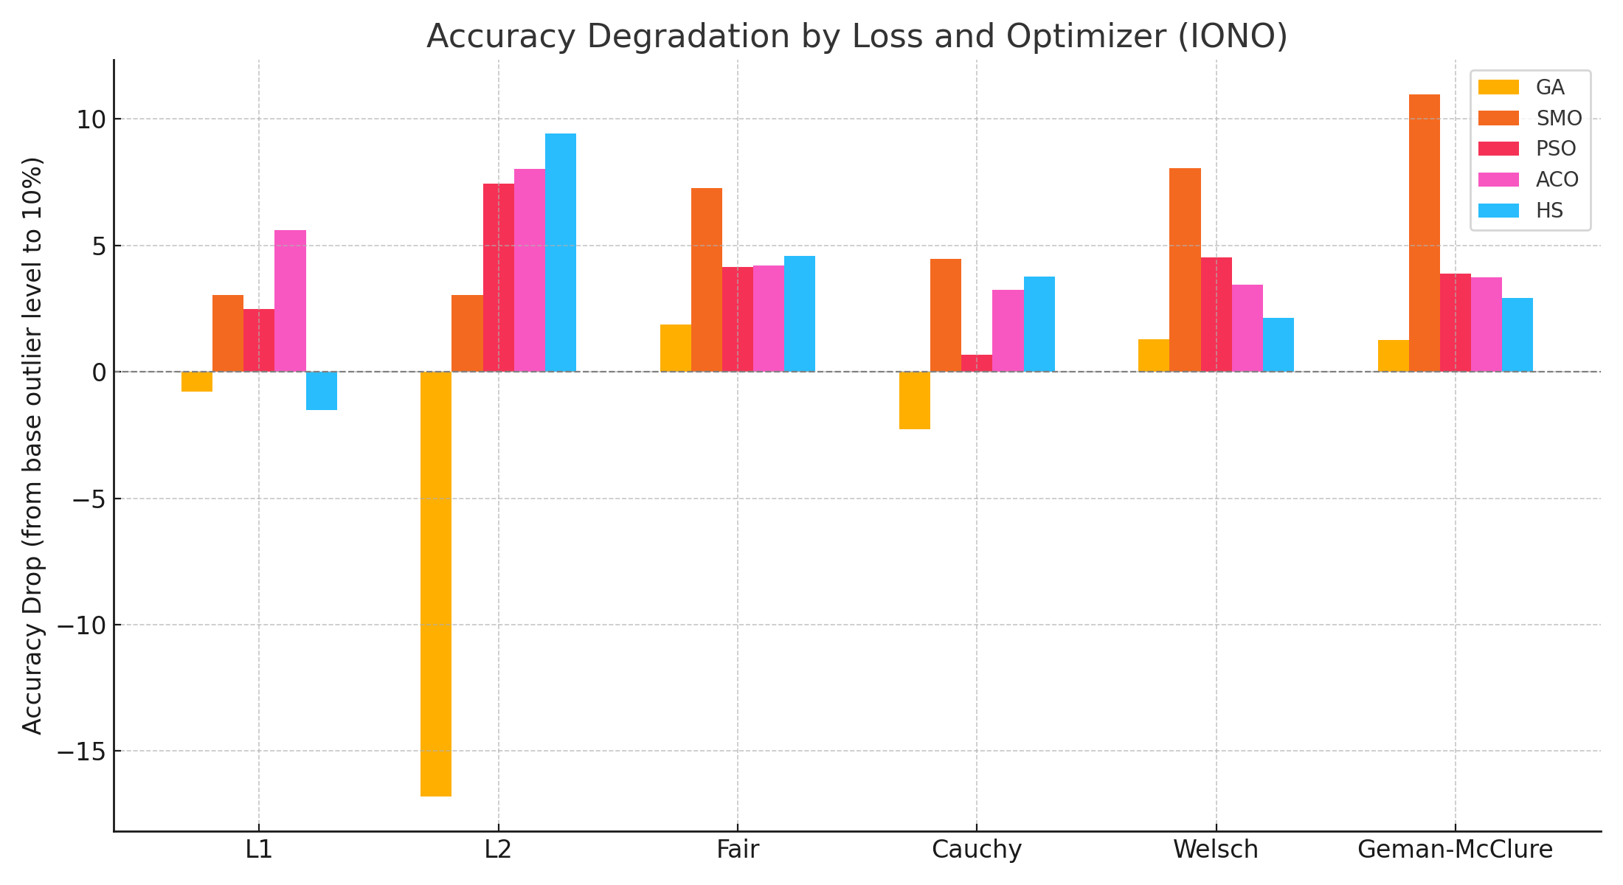
5. Data Analysis
43

Slide 44
5. Data Analysis
• Some combinations showed a negative degradation rate, meaning that their accuracy
improved after adding more outliers.
While interesting, these cases may be due to noise patterns or random variations.
So for robust conclusion, we focus only on models with the smallest positive degradation,
indicating consistent performance under increasing outlier conditions.
44

Slide 45
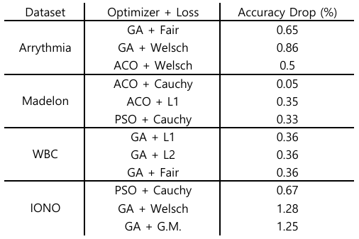
5. Data Analysis
• After excluding the combinations where accuracy improved unexpectedly, we identified
the most robust models by their lowest positive degradation.
These results represent the combinations that consistently maintained performance as
outlier ratios increased to 10%.
45
Notes:
이 표는 이상치 비율을 10%로 높였을 때, 정확도 감소율이 가장 낮았던 조합들을 보여줍니다. 예를 들어 Arrhythmia에서는 GA + Fair, Madelon에서는 ACO + Cauchy, IONO에서는 PSO + Cauchy 조합이 가장 강건한 성능을 보였습니다. 이러한 결과는 M-추정 기반 손실함수와 적절한 최적화 알고리즘을 결합하면 이상치에 대한 저항력을 효과적으로 높일 수 있다는 것을 보여줍니다.

Slide 46
6. Conclusion
• Support vector Machines are widely used, but they are known to be sensitive to outliers.
Our goal was to enhance SVM’s robustness using M-estimation-based loss functions.
• We experimented with 6 different loss functions and 5 optimization algorithms across
4 datasets, evaluating how each model responded to increased outlier levels.
46

Slide 47
6. Conclusion
• The results show that M-estimation-based loss functions – particularly Cauchy and Welsch
– combined with optimizers like ACO or PSO, offer superior robustness against outliers.
For example, PSO + Cauchy on Ionosphere and ACO + Cauchy on Madelon showed minimal
accuracy drop even with 10% outliers.
• This suggests that SVMs can be made significantly more robust by choosing the right
combination of loss and optimization strategy.
In future work, we aim to extent this to multi-class problems and apply it to real-work
datasets such as biomedical or financial data.
47

Slide 48




